Slide 1
Self-Directed Learning
by
Patricia Williams

Slide 2
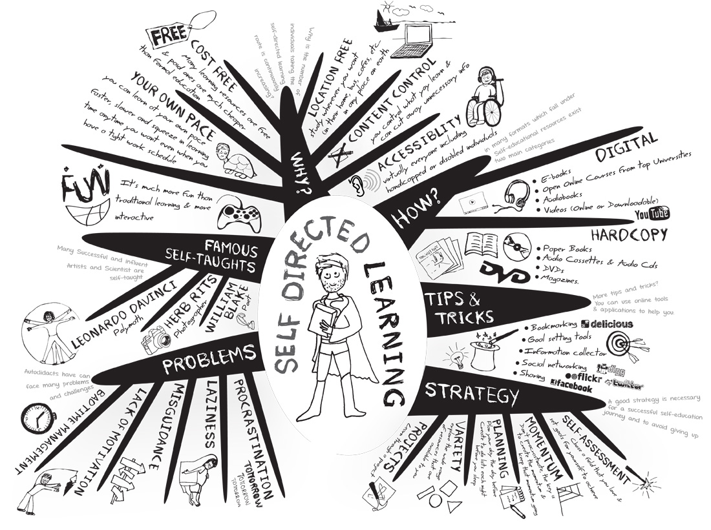
What is Self-directed Learning?
Up to 90% of adults are engaged in some form of self-directed learning.
In self-directed learning, the learner takes control of his or her own learning.
All adults have the capacity to be self-learners, but some factors may affect their ability to choose SDL
Willingness
Motivation
Life Circumstances
Image from: astrae @ www.teachthuoght.com

Slide 3
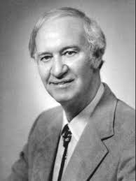
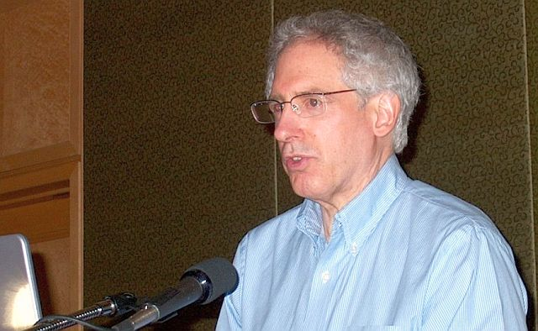
History of SDL
Malcolm Knowles – described and studied SDL
“individuals take the initiative with or without the help of others”
Created a 6-step process for adult learners.
Allen Tough – studied and broadened SDL.
looked at it from a project aspect
Set a minimum amount of time for a SDL project.
Like Knowles, he also had a step-wise process for SDL
Allen Tough
Image from www.allentough.com
Malcolm Knowles
Image from: web.utk.edu

Slide 4
Knowles versus Tough: The SDL Process
Knowles (1975) 6-Step process
Tough (1978) Step-wise process
Climate setting – creating an atmosphere of mutual respect and support
Diagnosing learning needs
Formulating learning goals
Identifying human and material resources for learning.
Choosing and implementing appropriate learning strategies
Evaluating learning outcomes
Setting goals and timelines
Determining pace
Assessing the current level of knowledge or skill
Learner evaluation of learning – student adjusts learning as opposed to an instructor.

Slide 5
Goals or Ideas that Motivate Learners (According to Caffarella 2000)
To be self-directed / Take Control
Aspiration to gain knowledge or develop a skill
Transformational learning – Critical reflection
Emancipatory – social justice or political action

Slide 6
Types of SDL
Synergistic SDL
Inspired by opportunity (good or bad)
Individual is “unconsciously incompetent” because they have no previous knowledge of the topic.
Voluntary SDL
Individual is “consciously competent” in knowing what they need to do in order to obtain the goal.
Scanning SDL
The ongoing process of searching and learning
Think of professional development in our professional careers

Slide 7
Types of Self Directed learners by Costa and Kallick (table 4.2 p.75)
Self-managing –
Draws from prior knowledge
Displays internal locus of control
Manages time effectively
Produces new knowledge through their own research
Self-monitoring –
Pursues ambiguities and possibilities to create new meaning
Manages self in relationships to groups
Evaluates and corrects work to improve quality
Self-modifying –
Seeks feedback
Reflects and learns from experience
Receives feedback and acts on it

Slide 8
Myths about SDL
SDL is an all-or-nothing concept
SDL is the best approach for adults
Self-direction implies isolation
SDL is limited to white, middle-class adults
SDL is limited to reading and writing
Not worth the time

Slide 9
Critiques of SDL – by some researchers
Concerns about Facilitation of SDL
Brookfield 1984
SDL assumes all adults desire self-direction
Cultures may be averse to the learning technique
Is SDL still relevant? Research is limited on the process
Some could lack the means / resources

Slide 10
Resources
Merriam, S. B., & Bierema, L. L. (2013). Adult learning: Linking theory and practice. John Wiley & Sons.

